Slide 1
Final Presentation
By Andrew O. and Andrew F.

Slide 2
Our Mission
Our Dataset
Answer questions using student athlete tutorial session data to inform best practices and ensure best possible attendance by student athletes.
Our data consisted of all student athlete tutorial sessions registered in the 23/24 school year.

Slide 3
Question 1: Which majors/schools correlate with the highest and lowest number of tutorial session cancellations? No shows?

Slide 4
Note Use of Primary Major
Did not have access to Major Desc at the time.
Majors will not reflect changes between Fall 2023 and Spring 2024 for this part.
Not many student athletes changed majors so results should not be drastically altered.

Slide 5
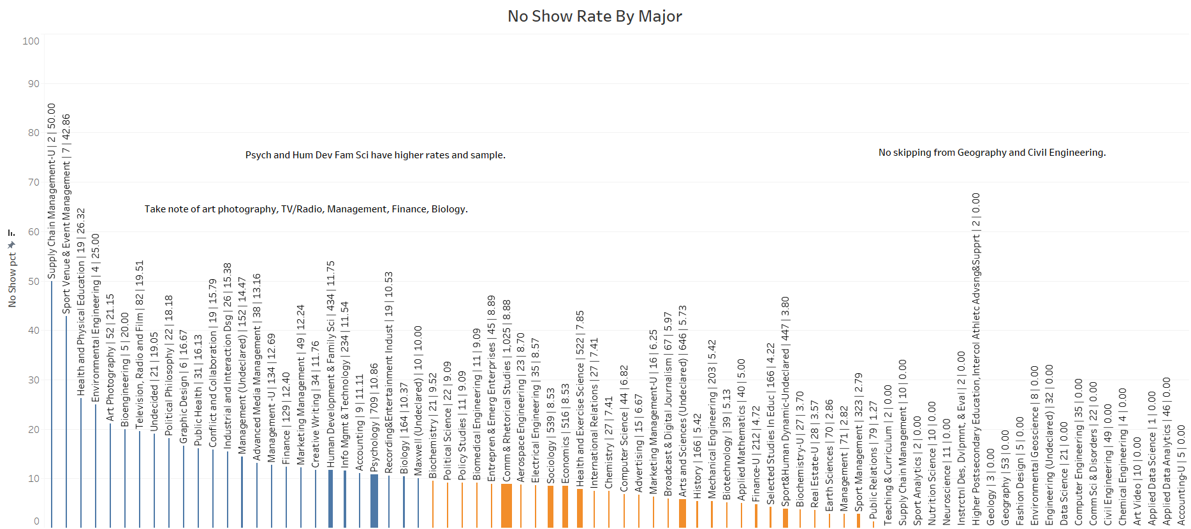

Slide 6
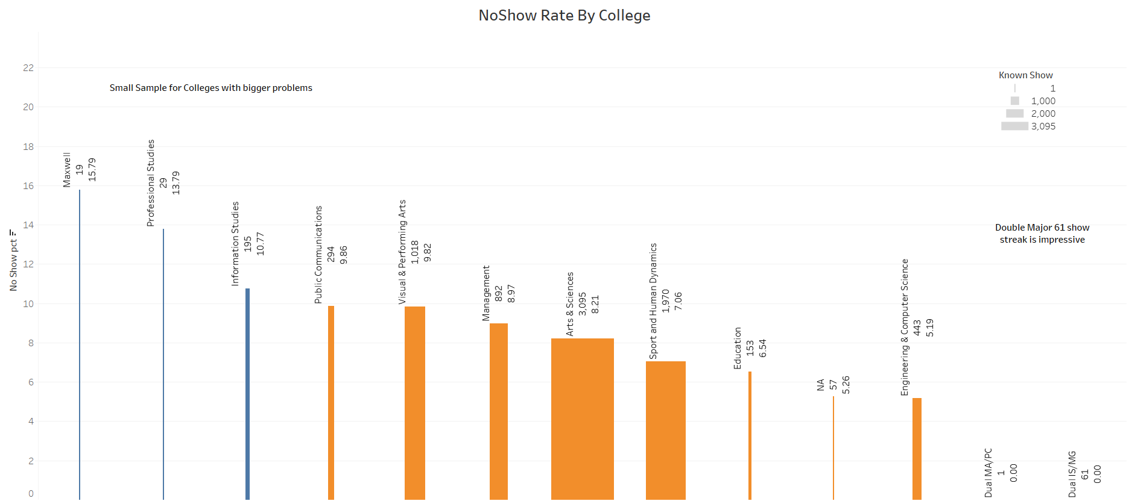

Slide 7
Major No Show Model Results (TOo Large For Screenshot)
Stat Sig Majors: Sport Venue & Event Management, Supply Chain Management Undecided
Almost .4 coefficients for both (IsNoShow is a dummy variable)

Slide 8
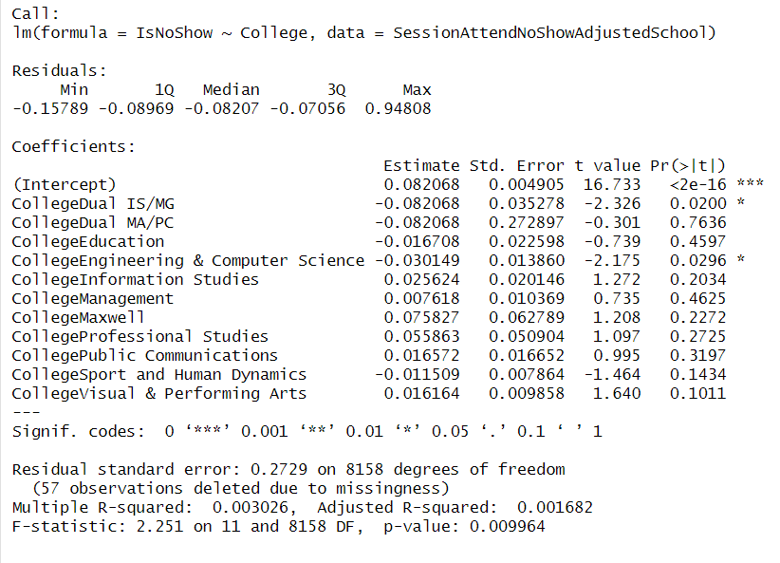
College No Show Model Results
Dual Major IS/MG small sample (1 Show).
Engineering and Comp Sci students may be found to be good at showing up with larger sample size.

Slide 9
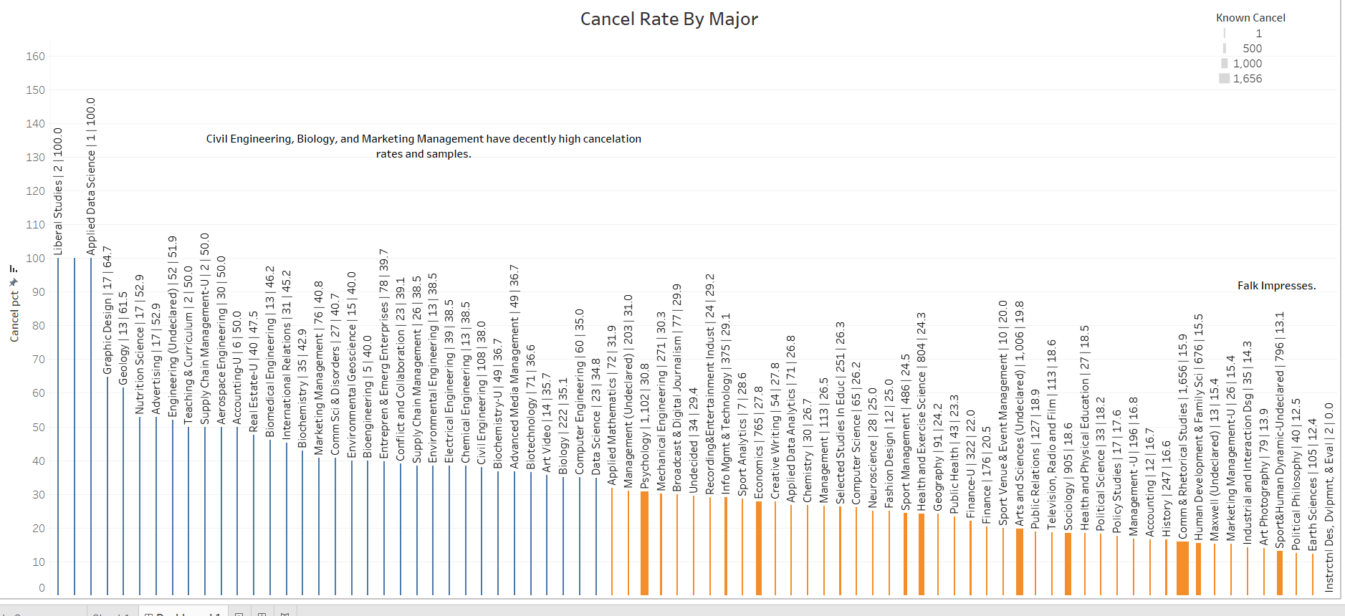

Slide 10
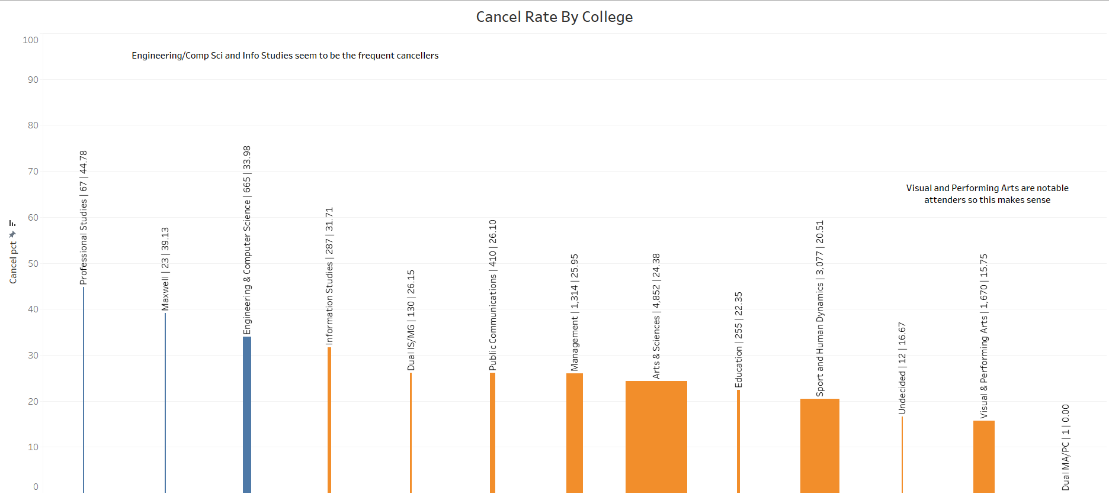

Slide 11
Major Cancel Model Results (TOo Large For Screenshot)
Stat Sig Majors: Real Estate Undeclared, Nutrition Science, Marketing Management, Liberal Studies, International Relations, Higher Postsecondary, Graphic Design, Geology, Entrepreneurship & EE, Engineering Undeclared, Com Sci and Disorders, Civil Engineering, Biomed Engineering, Biochem, Advertising, Aerospace Engineering, Applied Data Science
Coefficients in alignment with above: 0.3, 0.36, 0.24, 0.83, 0.28, 0.83, 0.44, 0.23, 0.35, o.24 , 0.21, 0.29, 0.26, 0.36, 0.33, 0.83 - All of these majors may be found to have cancelation issues with larger sample size – small sample size caveat applies as this is only 2 semesters.

Slide 12
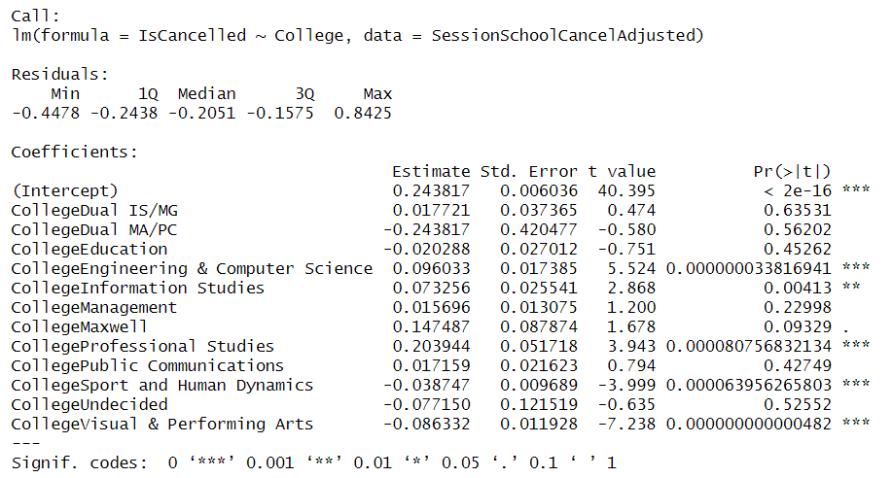
College Cancel Model Results
Maxwell small sample but can take some stock (sig at 10% level).
Engineering and Comp Sci, Info Studies, and Pro Studies may have a significant cancellation problem.
Falk and Visual Arts good attendance reinforced.

Slide 13
Question 2: Which majors/schools correlate with the highest and lowest credit loads per semester? Total hours in the classroom weekly? Total hours of tutoring weekly?

Slide 14
Note
Average Attend % = 68.8
Average Not Cancel % = 76.9
Sample: 13667 total sessions, about 8230 sessions where attendance is known, 8161 sessions where weather and attendance is known

Slide 15
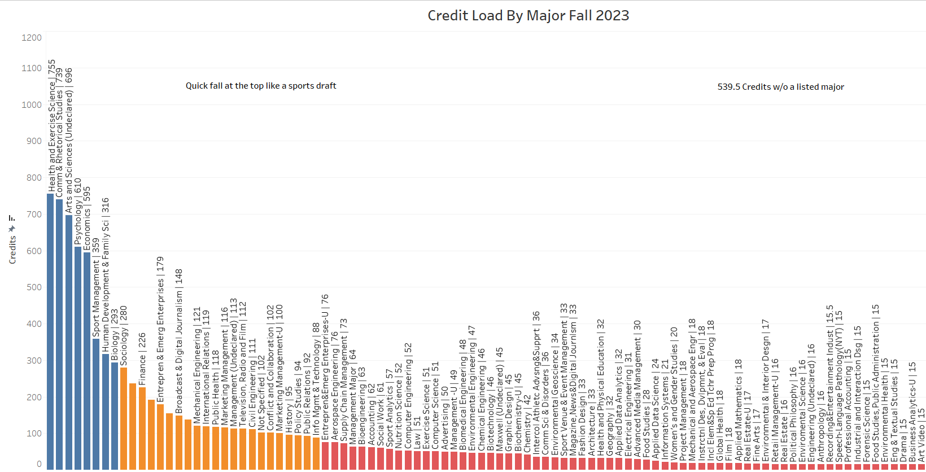

Slide 16
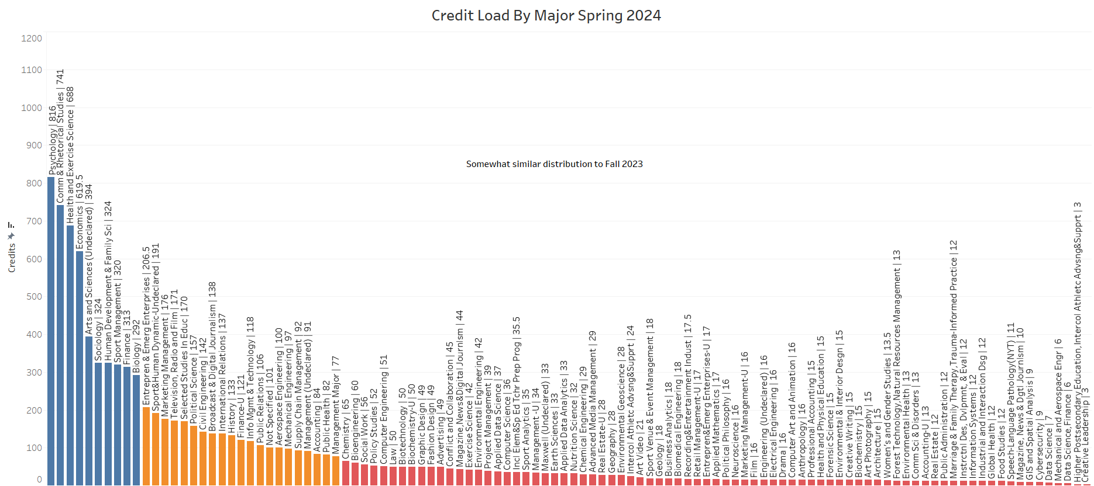

Slide 17
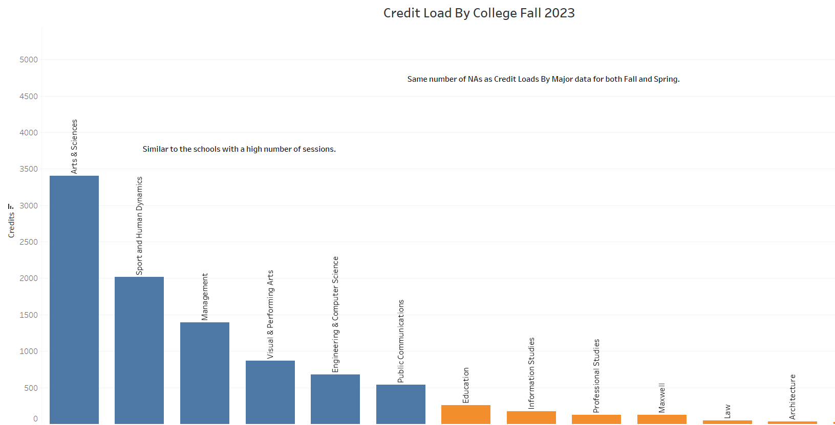

Slide 18
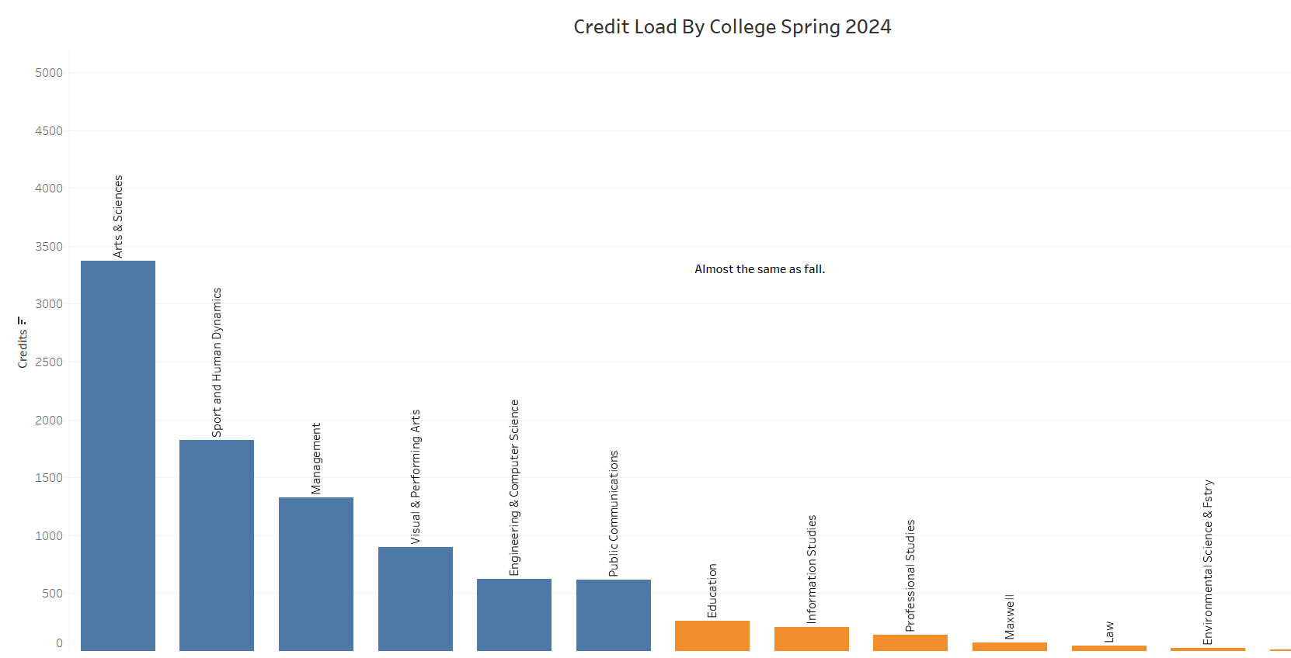

Slide 19
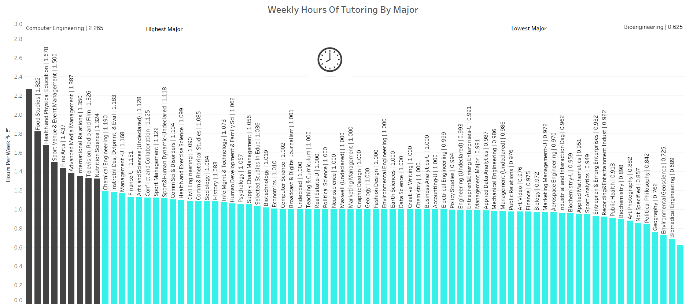

Slide 20
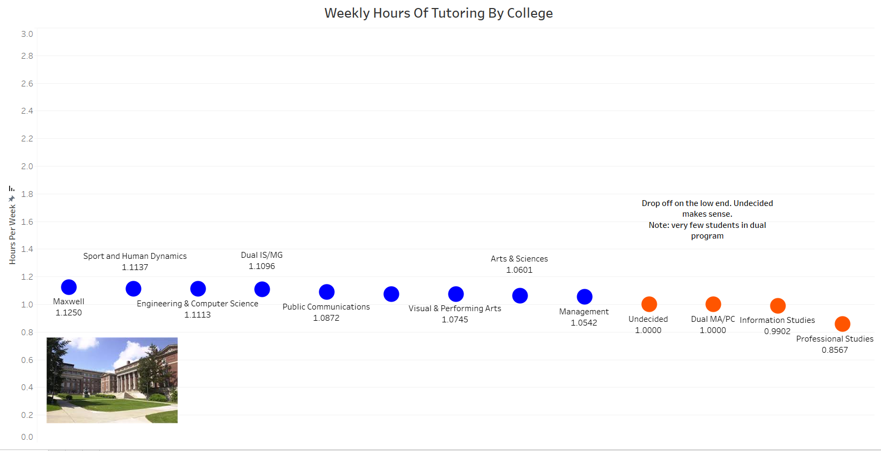

Slide 21
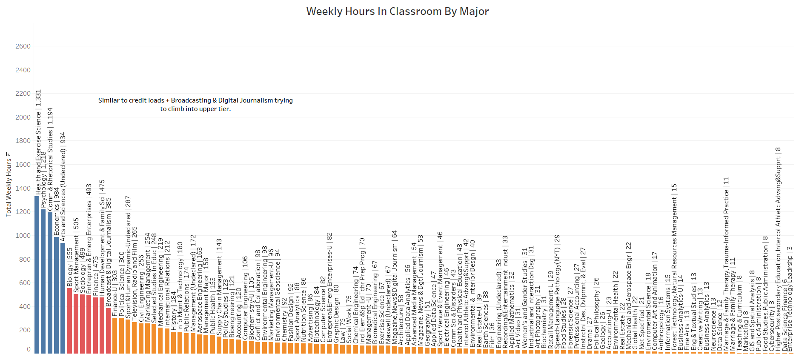

Slide 22
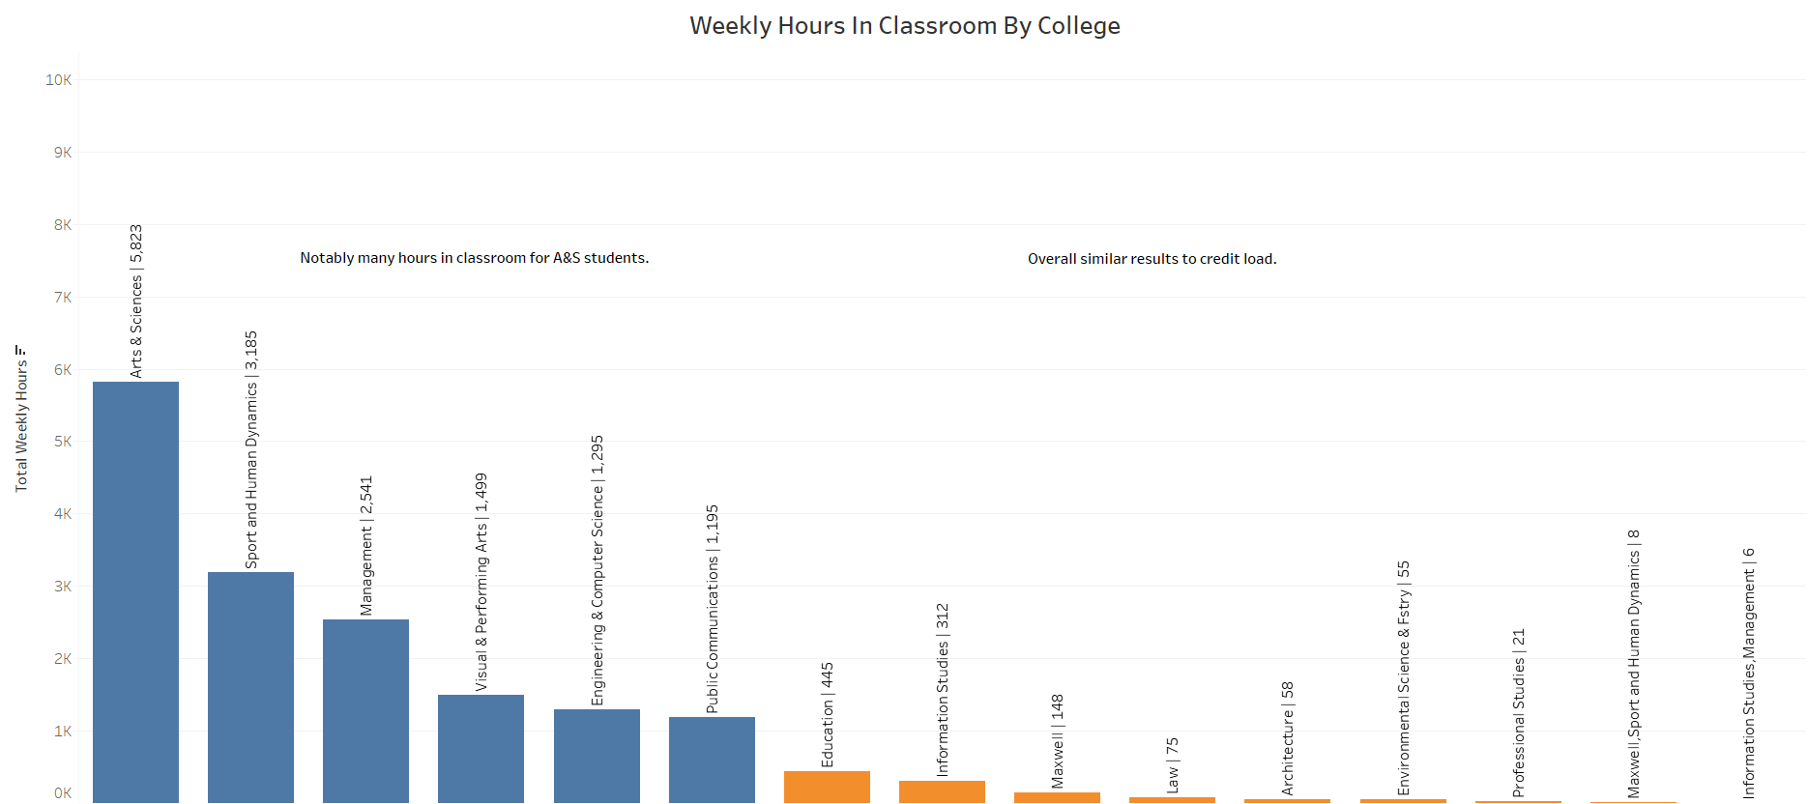

Slide 23
Question 3: How does a sport's status as in/out of season influence tutorial session scheduling? Attendance?

Slide 24
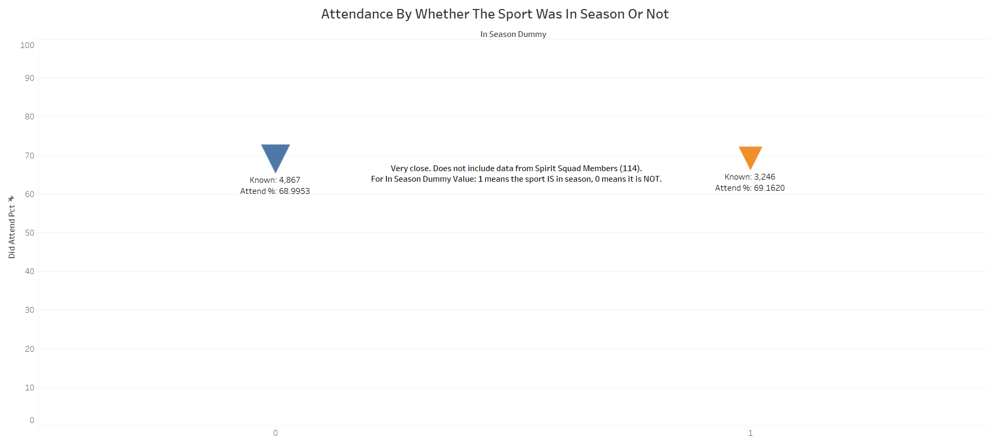

Slide 25
Question 4: For whom are tutoring sessions scheduled most, and least, often? What characteristics are shared by students who most often, or least, often attend scheduled tutoring sessions once they are scheduled?

Slide 26
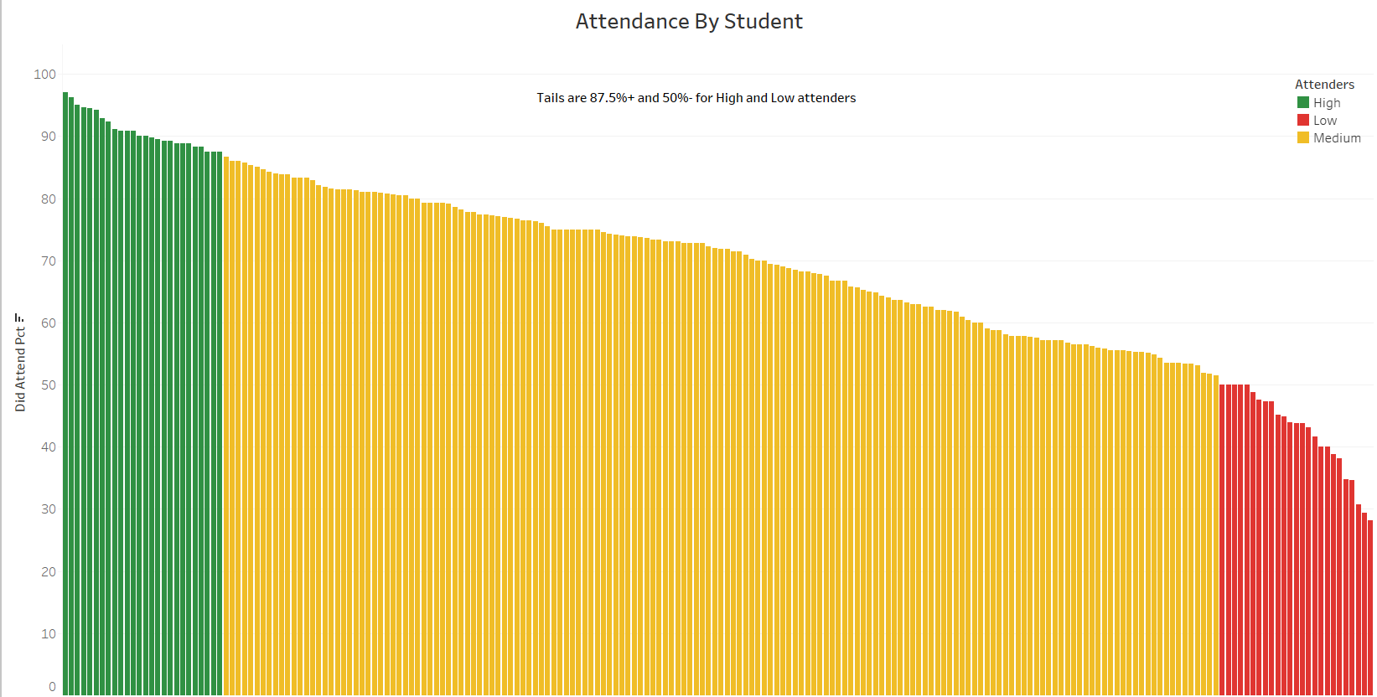

Slide 27
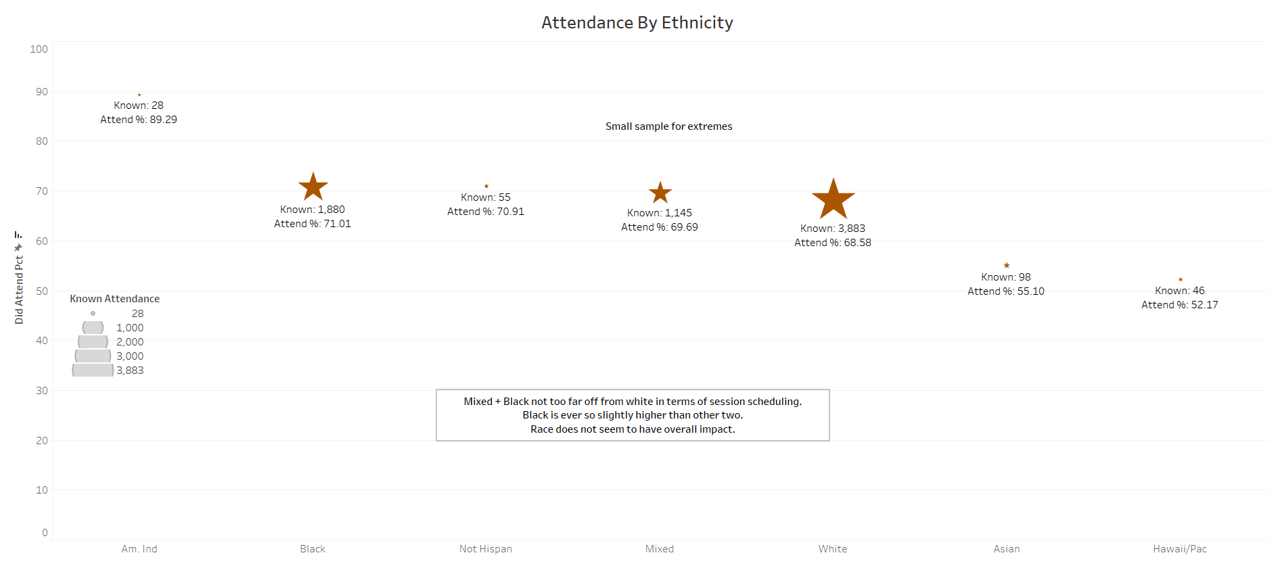

Slide 28
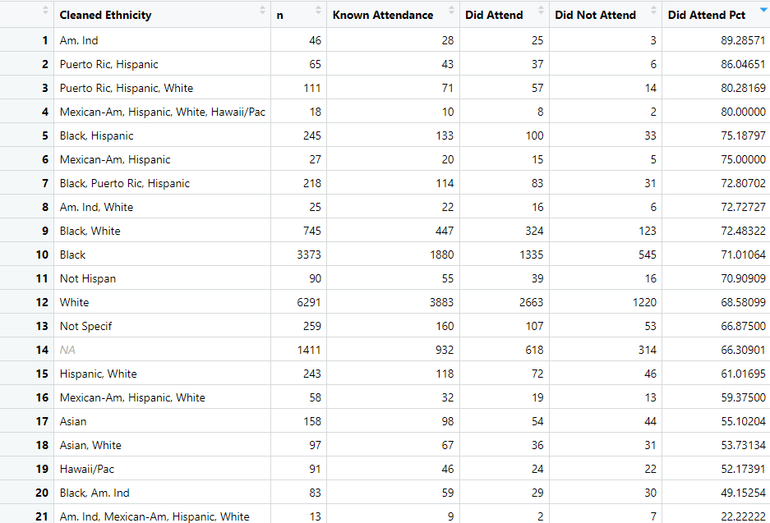
Table That Shows How Mixed Race Athletes Are Mixed – Any Ethnicity With a Comma

Slide 29
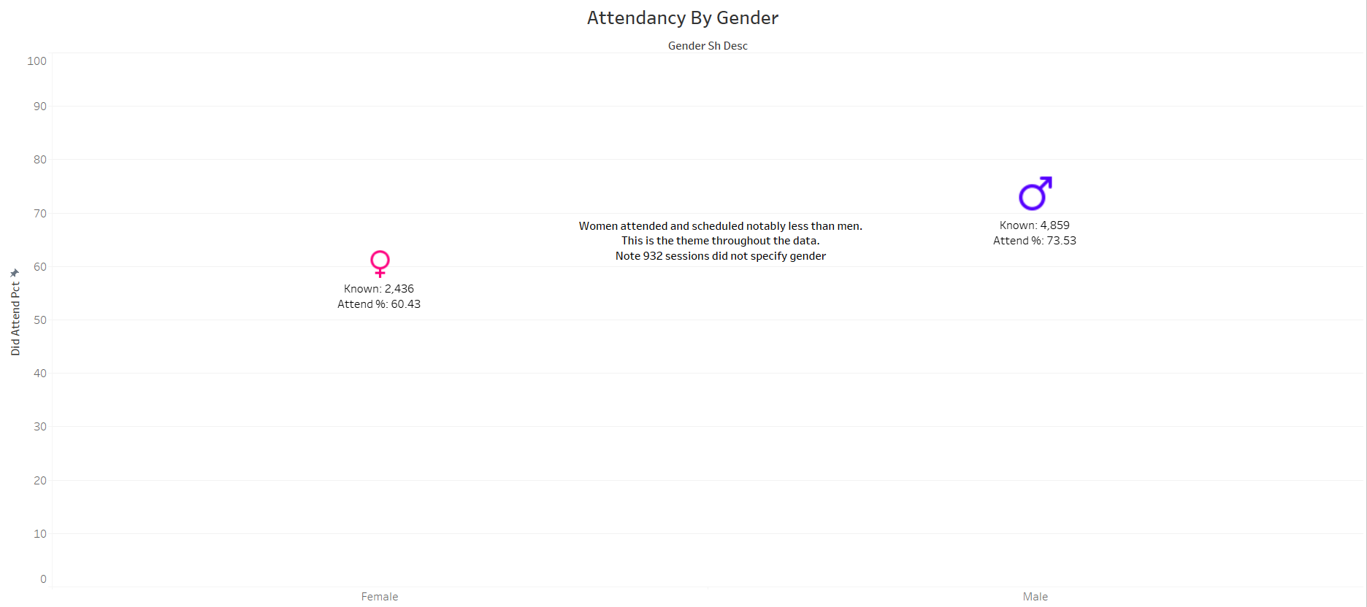

Slide 30
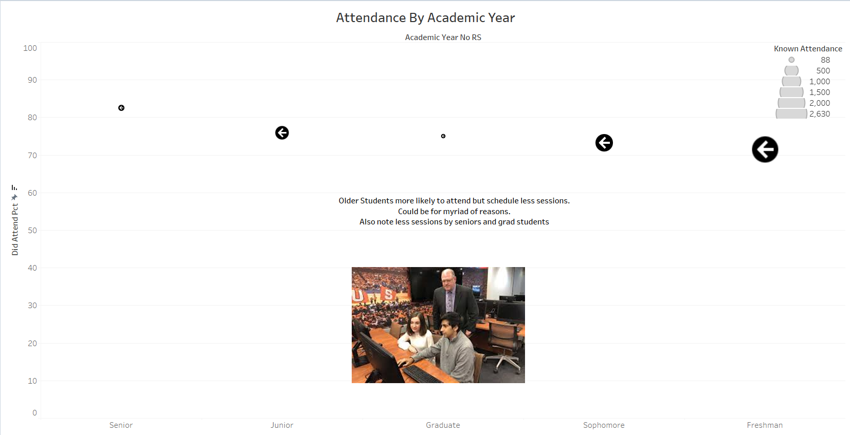

Slide 31
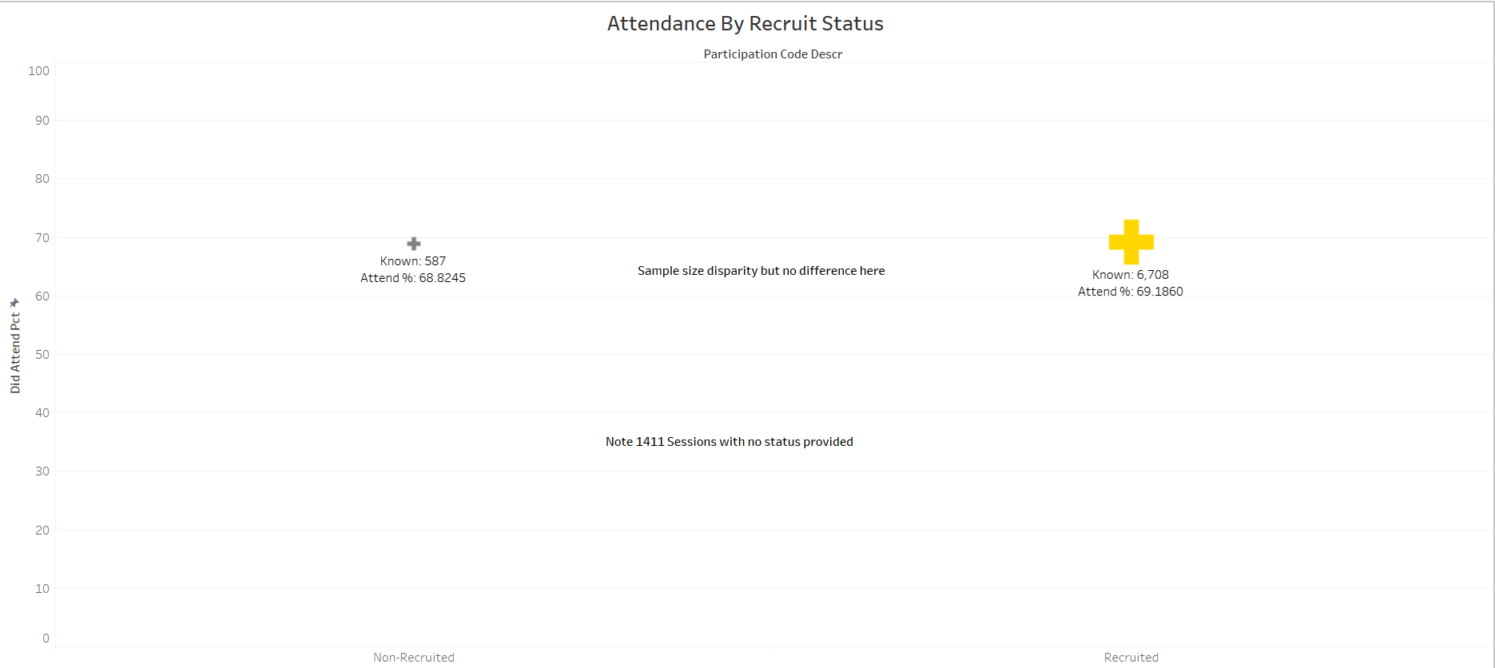

Slide 32
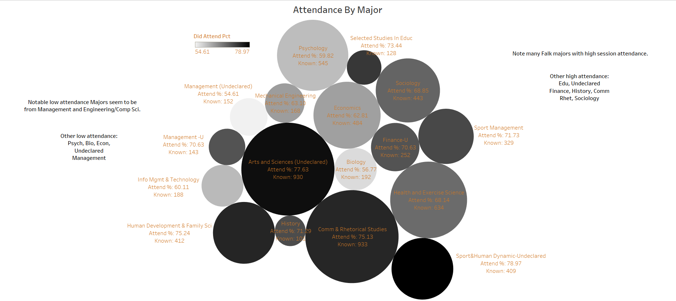

Slide 33
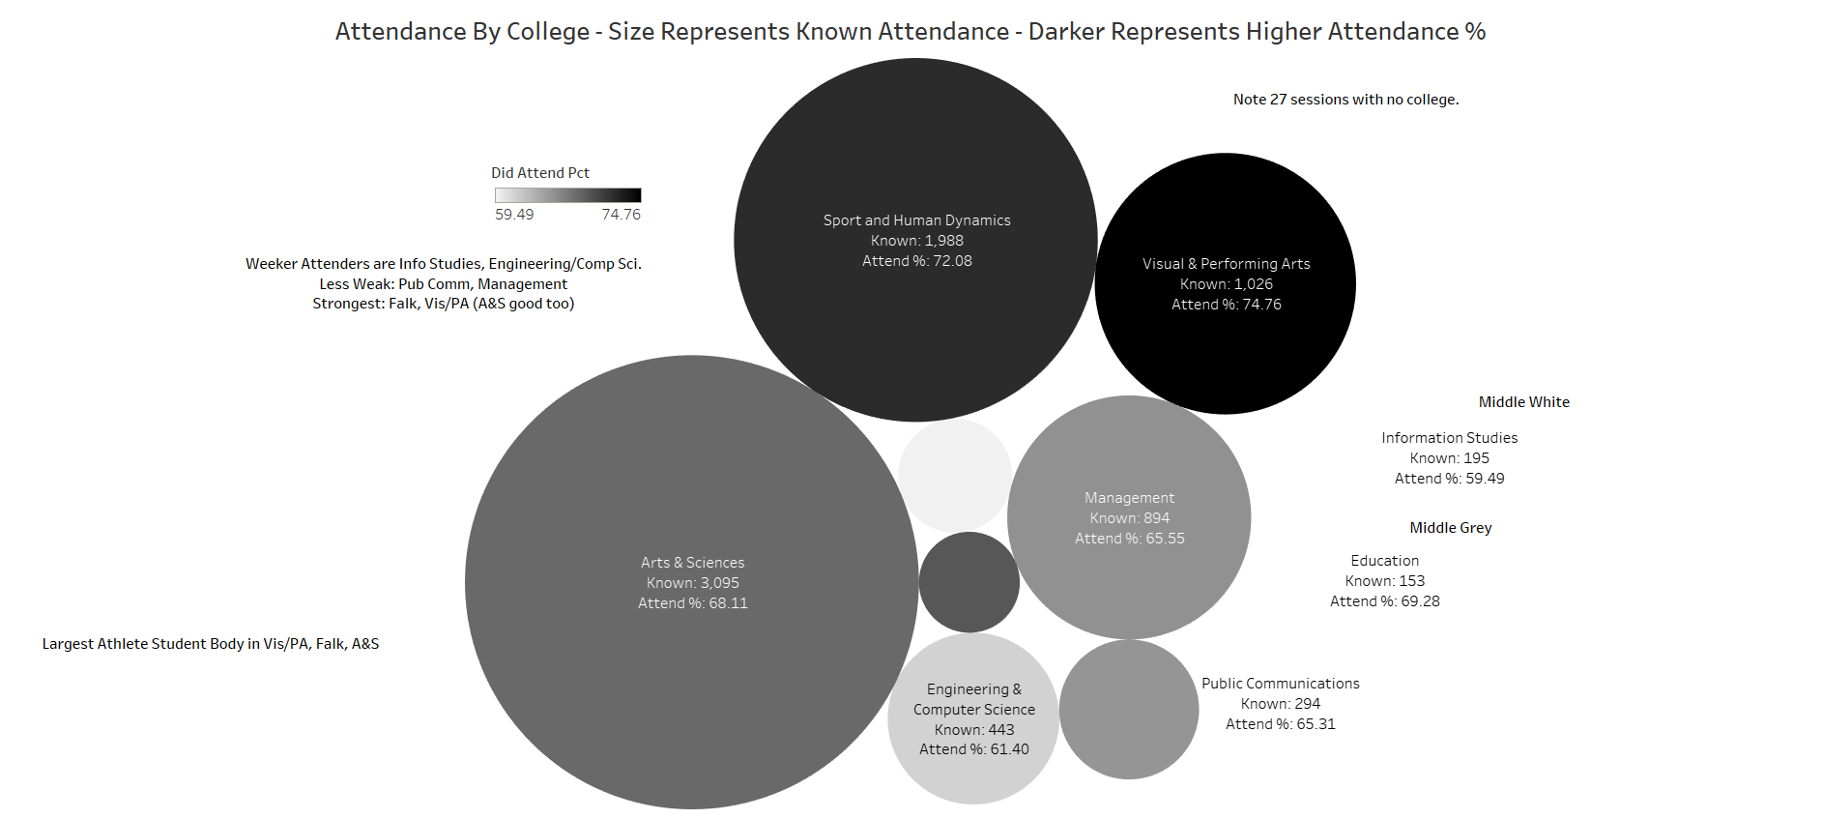

Slide 34
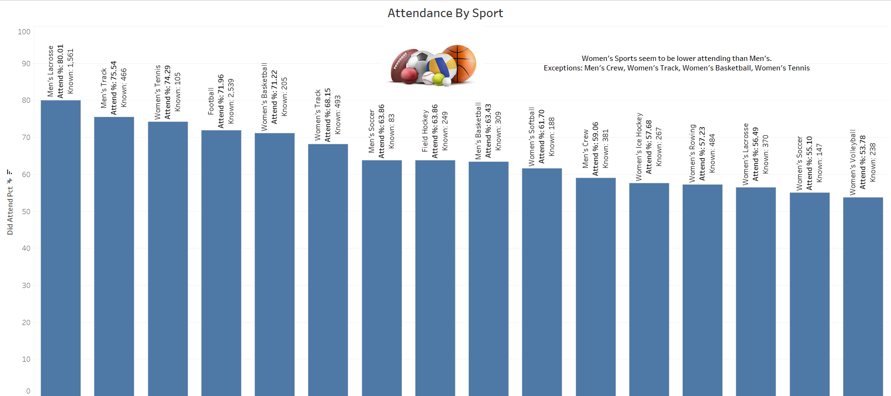

Slide 35
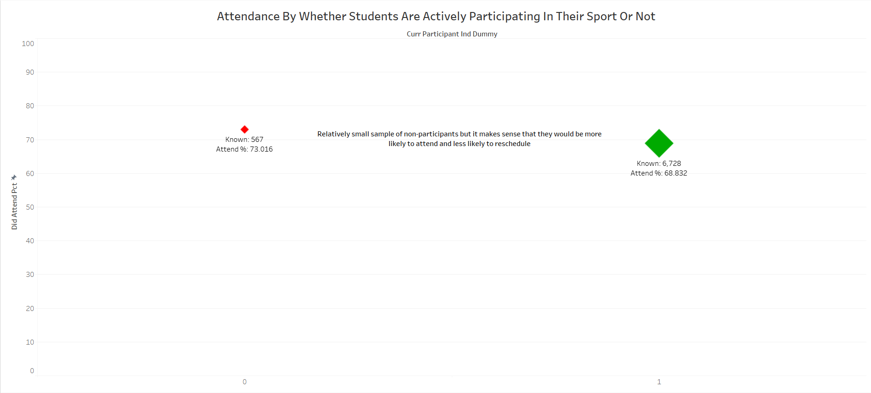

Slide 36
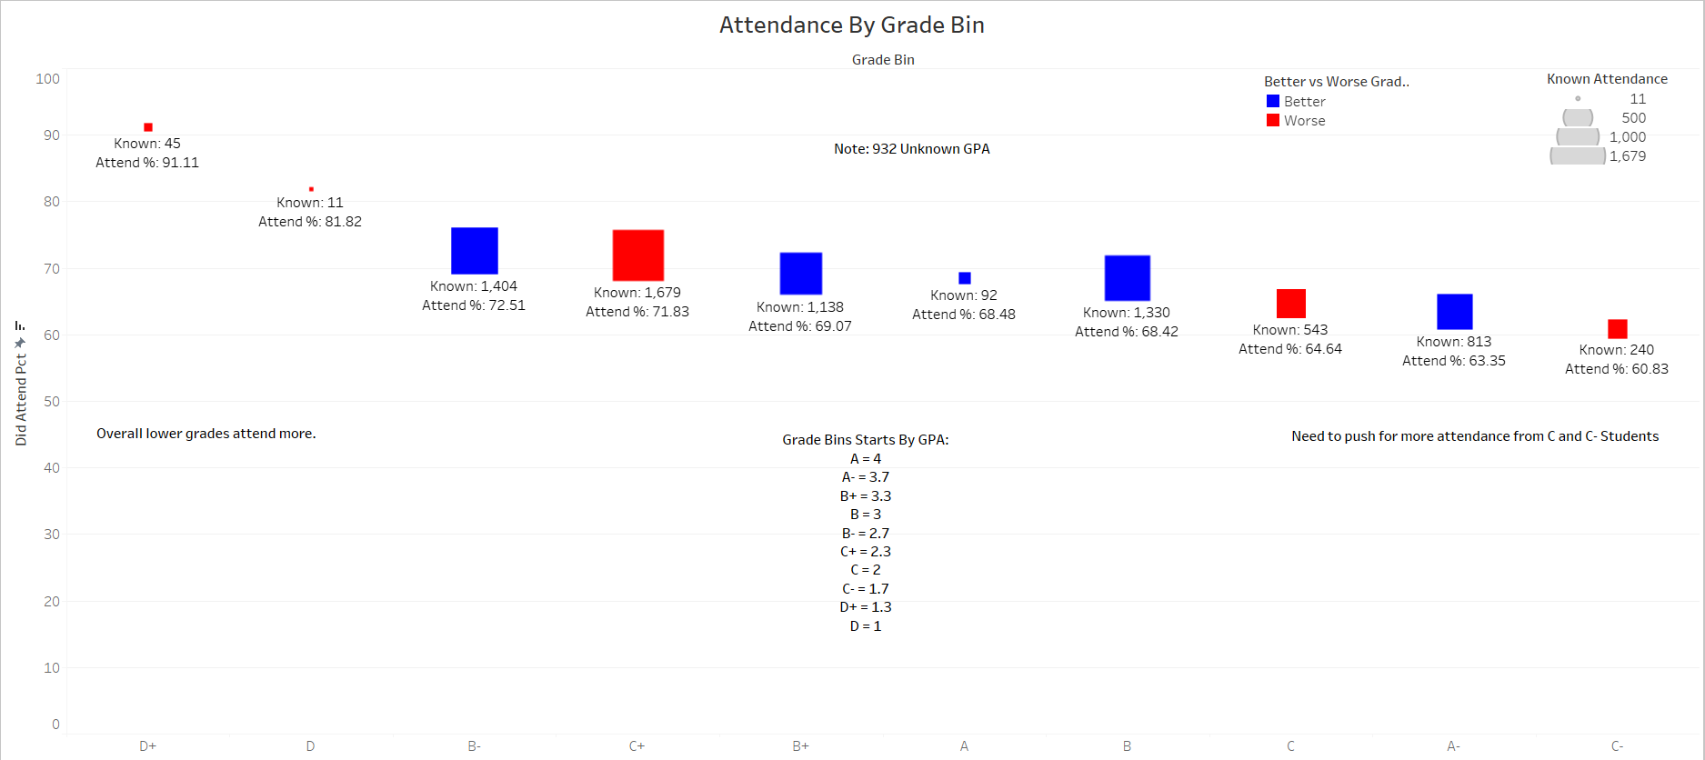

Slide 37
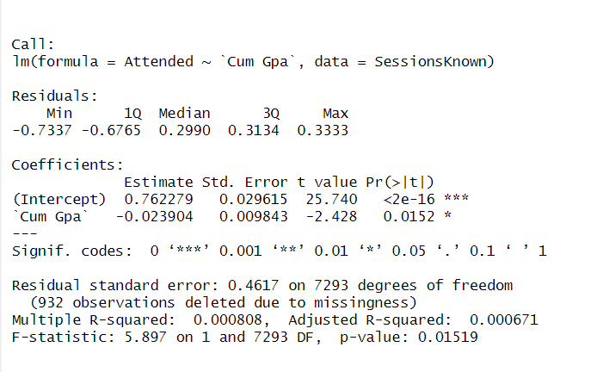
Model Of Cumulative GPA On Attendance
Attended is dummy var as to whether a session was attended or not
There is an estimated 2% (very marginal) statistically significant negative effect on attendance as GPA rises.

Slide 38
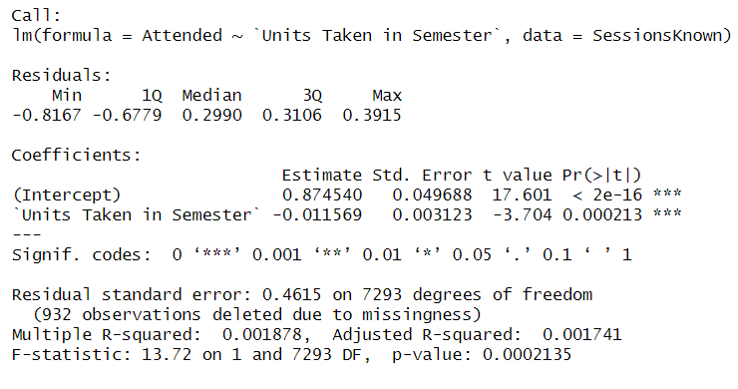
Model Of Credits Taken In Semester On Attendance
Even smaller effect than previous

Slide 39
Question 5: During which parts of the year are sessions most often attended, cancelled, or missed?

Slide 40
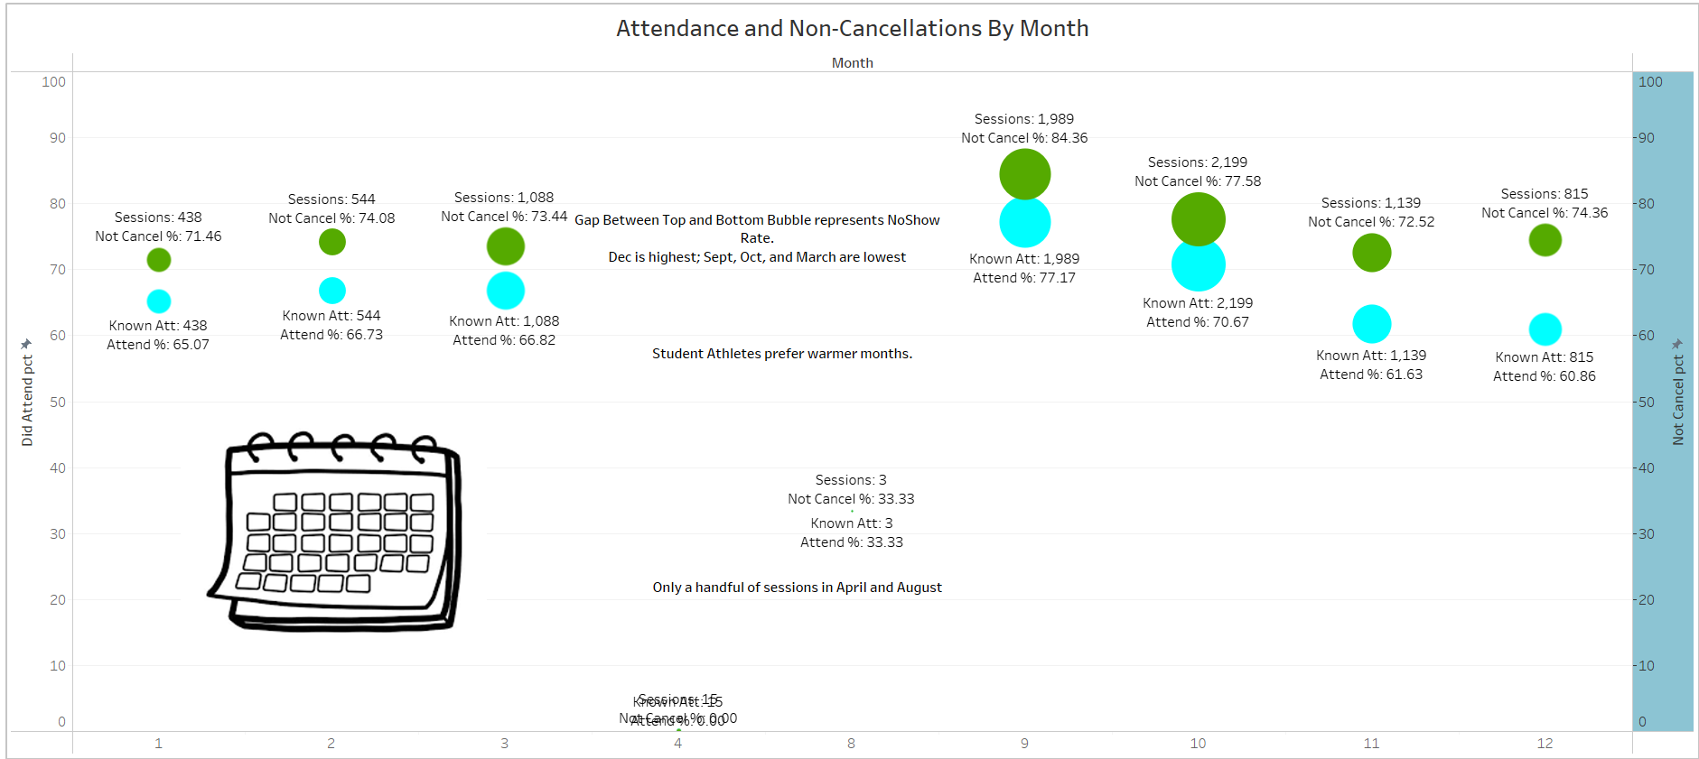

Slide 41
Question 6: How do weather conditions such as rain or snow influence rates of tutorial session attendance? Are the effects significantly correlated with any particular characteristics among groups of student-athletes?

Slide 42
Weather Jargon Notes
Sig Rainy Does not include drizzles
Snowy includes Wintry Mix
Windy implies 20+ mph wind speeds
For Temperature Bins in deg F: Below Freezing <= 32, Cold from 33-50, Hoodie Weather from 51-65, Nice from 66-85, Hot > 85
For Combo Bins: Below Freezing Or Cold and Hoodie Weather Or Nice combine temperature bins, Sig Rainly Or Snowy represent precipitation, Peaceful is if Hoodie Weather Or Nice and No Precip, Miserable is if Below Freezing Or Cold and there is Precip, for the Wind and Calm Air combos with and without Precip the wind speed for Wind is 15+ mph

Slide 43
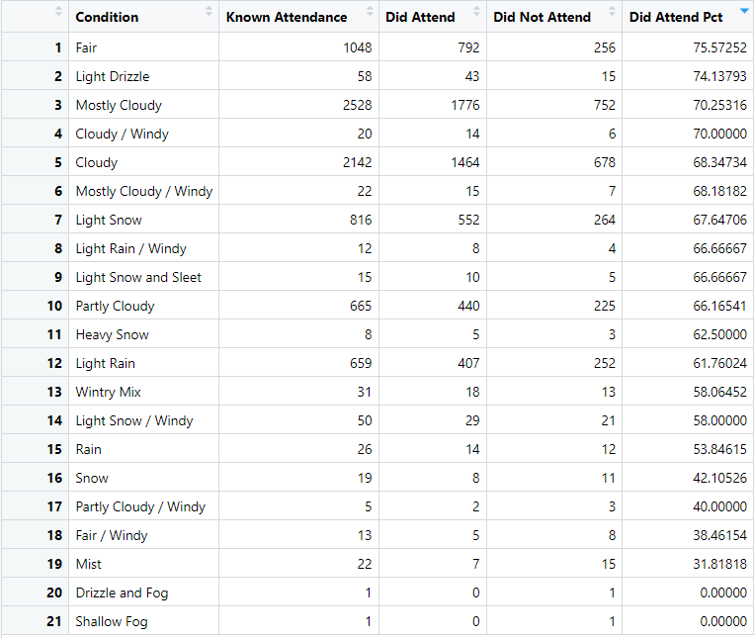
Conditions Provided From WUnderground

Slide 44
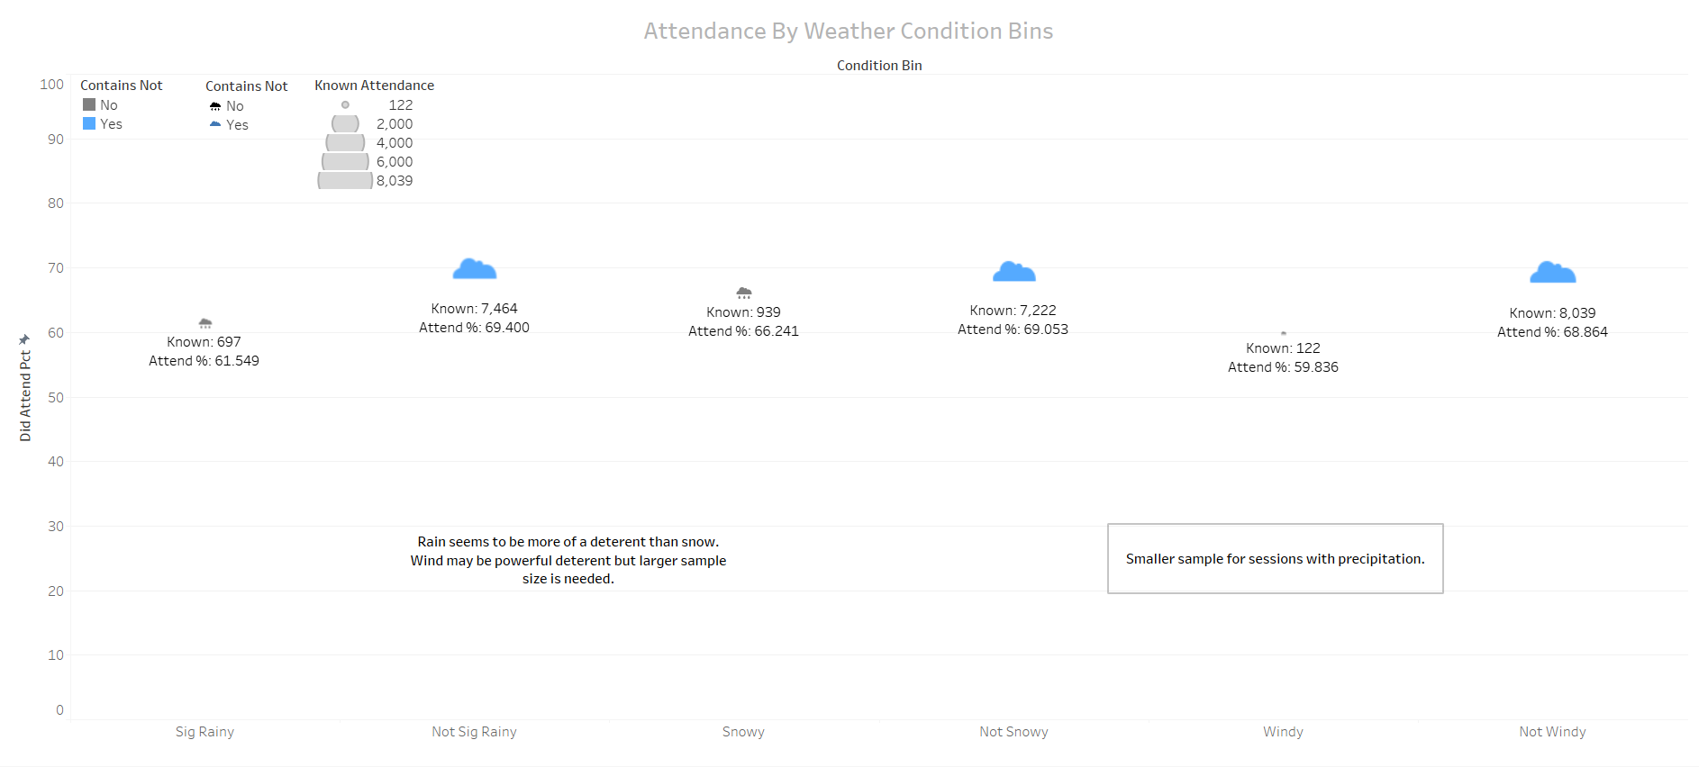

Slide 45
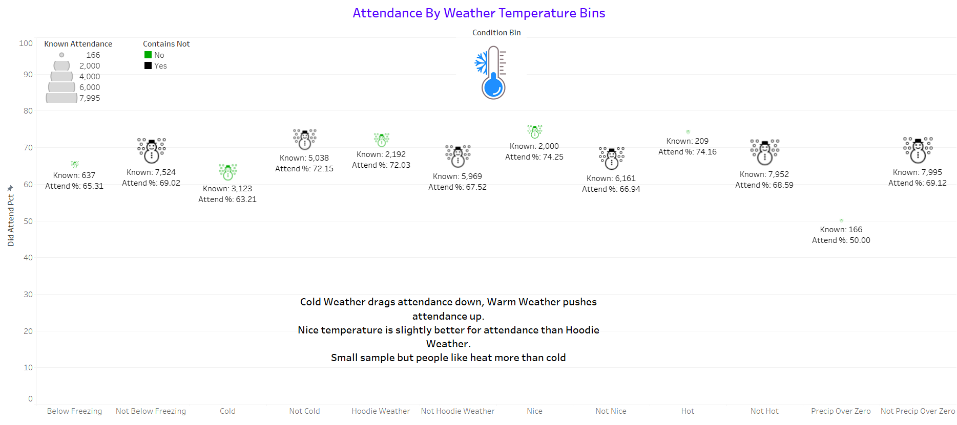

Slide 46
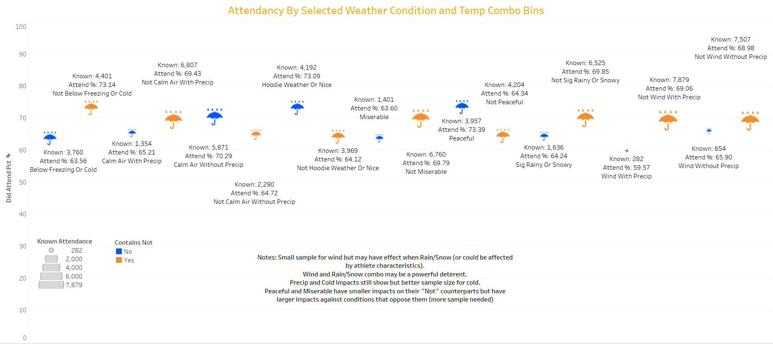

Slide 47
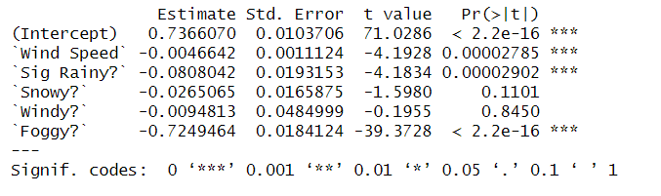
Weather Condition Model On Attendance
Wind Speed has marginal negative effect on attendance overall.
Rain has significant effect and so does fog but beware the small sample size (only 2 sessions for fog with both having non-attendance).

Slide 48
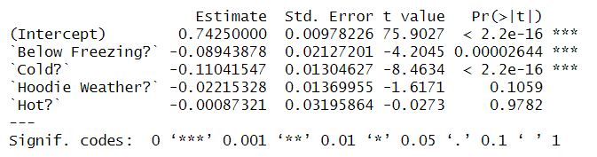
Temperature Model On Attendance
Cold weather has significant negative impact, reinforcing what has been found.

Slide 49
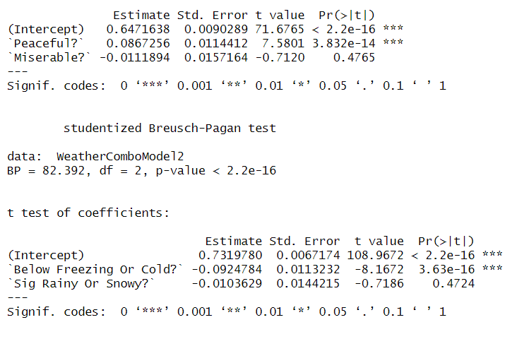
Temp Condition Combo Model On Attendance
Cold weather impact solidified
Overall precipitation, not so much
Miserable does not distinguish itself from cold as there are many cold weather days without precip.
Peaceful days do significant boost attendance as they contrast the many cold days.

Slide 50
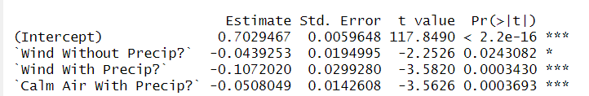
Temp Condition Combo Model On Attendance Part 2
These are compared to calm air without precip.
Here precipitation is significant and so is wind over 15mph. They have an effect that intensifies when there are both strong winds and precipitation.
The model was also ran with wind threshold changed to 20+ mph with coefficients of (left values) of 0.04, 0.1, and 0.05 from top to bottom, all statistically significant.

Slide 51
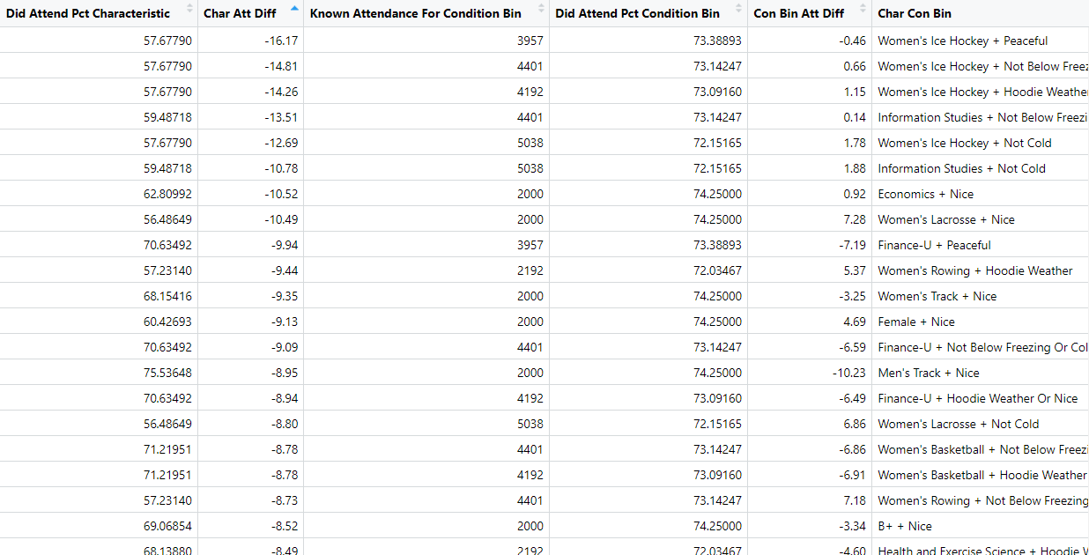
Primer For Remaining Weather Related Slides
Focus on 3rd and 5th column of this chunk of the table.
This represents the difference in session attendance between either the Student Athlete Characteristic (3rd) or Weather/Temp Conditon (5th) and the attendance of the sessions where both overlap.
Negative numbers represent overlap attendance increasing from characteristic while positive numbers reflect a decrease.
First half of following slides represents overlap attendance of at least 300 while second half represent overlap attendace of 100-299.

Slide 52
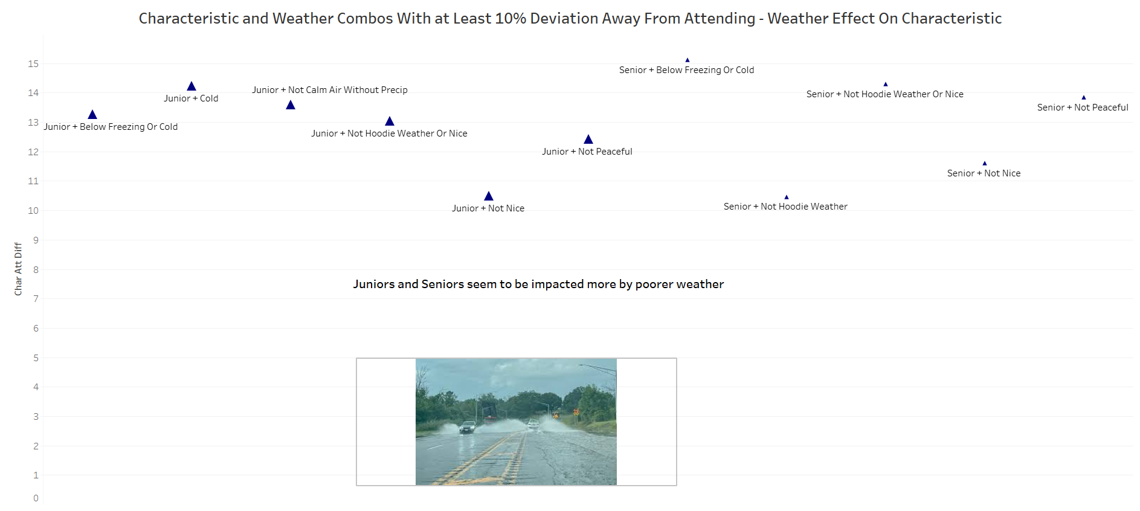

Slide 53
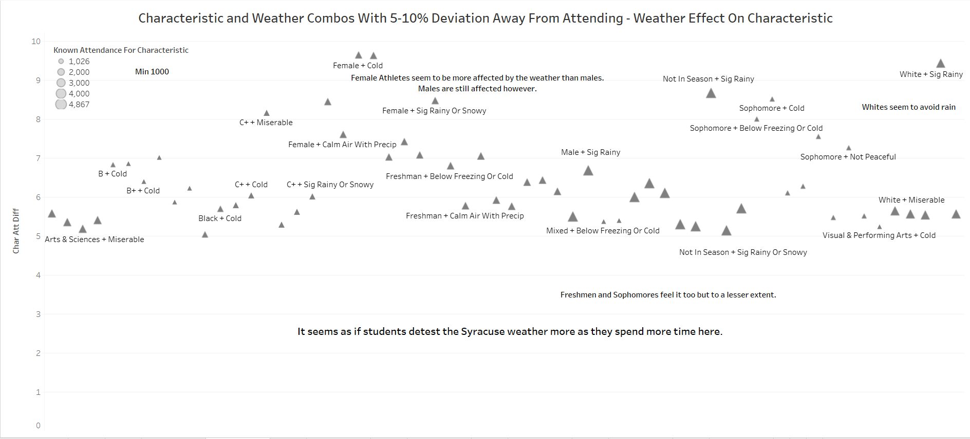

Slide 54
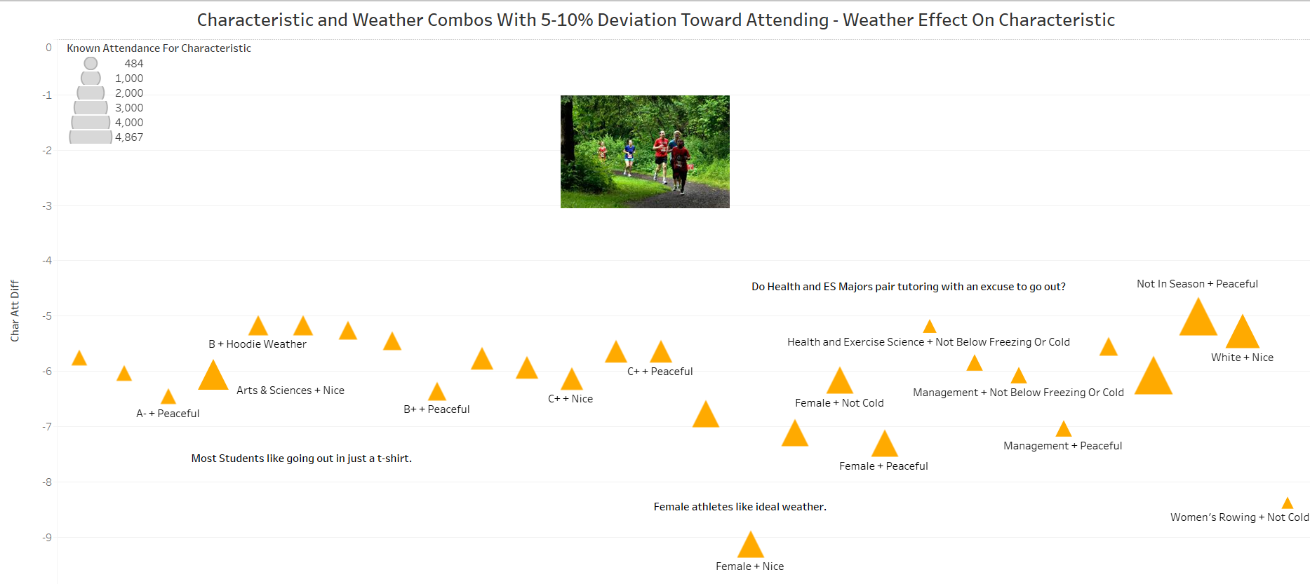

Slide 55
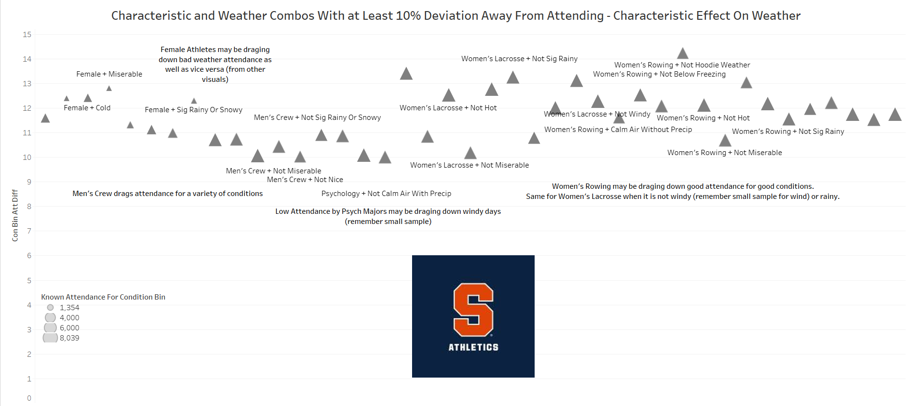

Slide 56
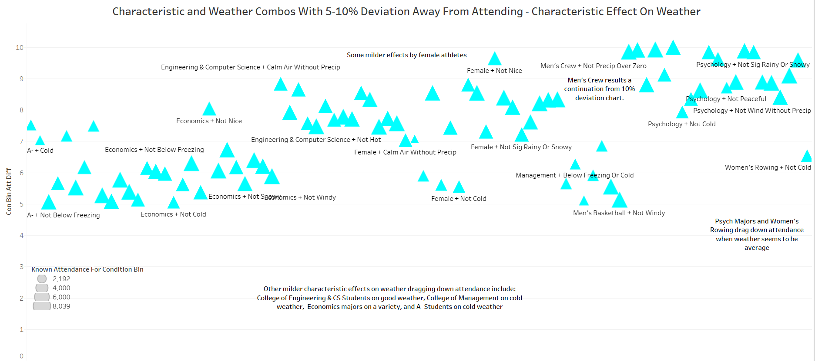

Slide 57
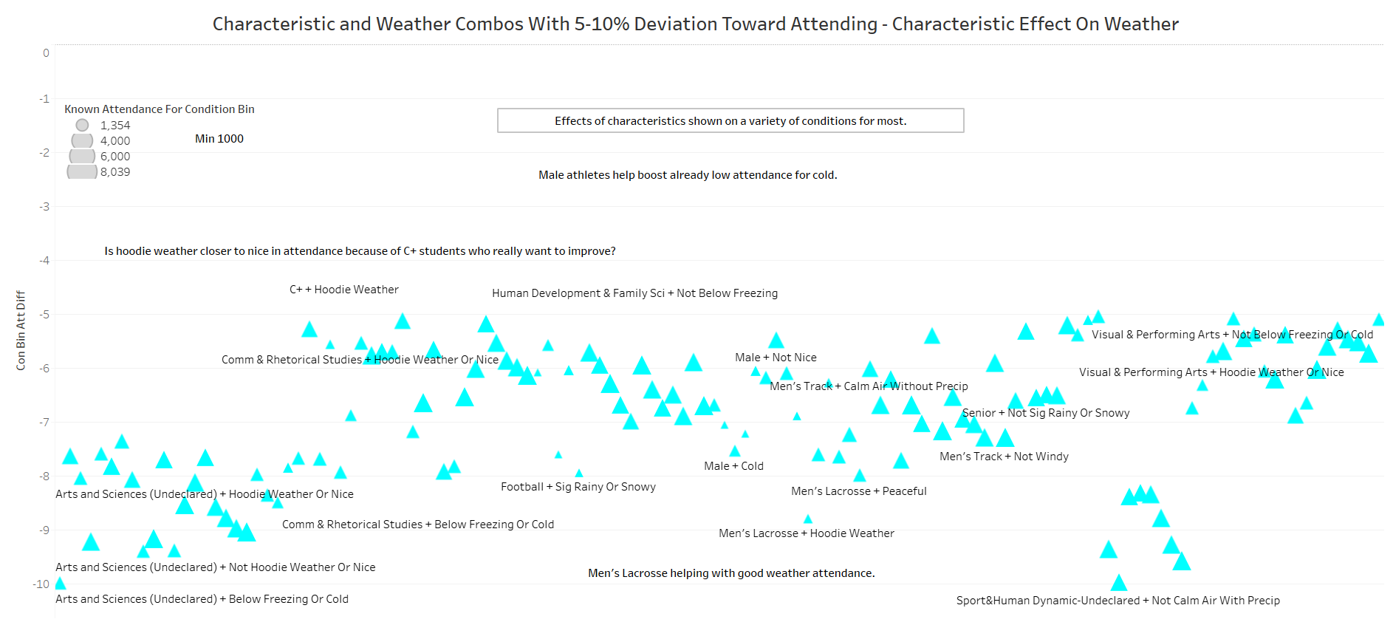

Slide 58
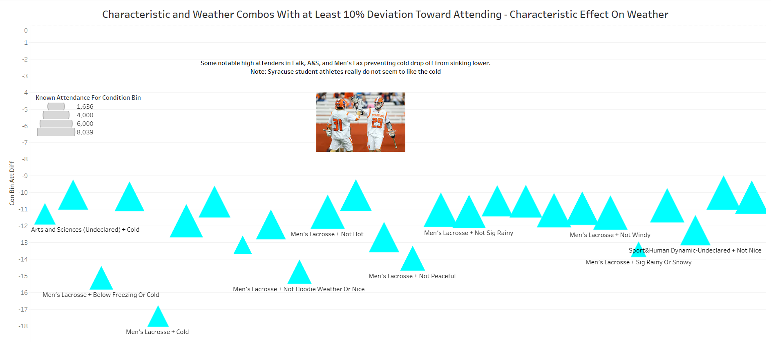

Slide 59
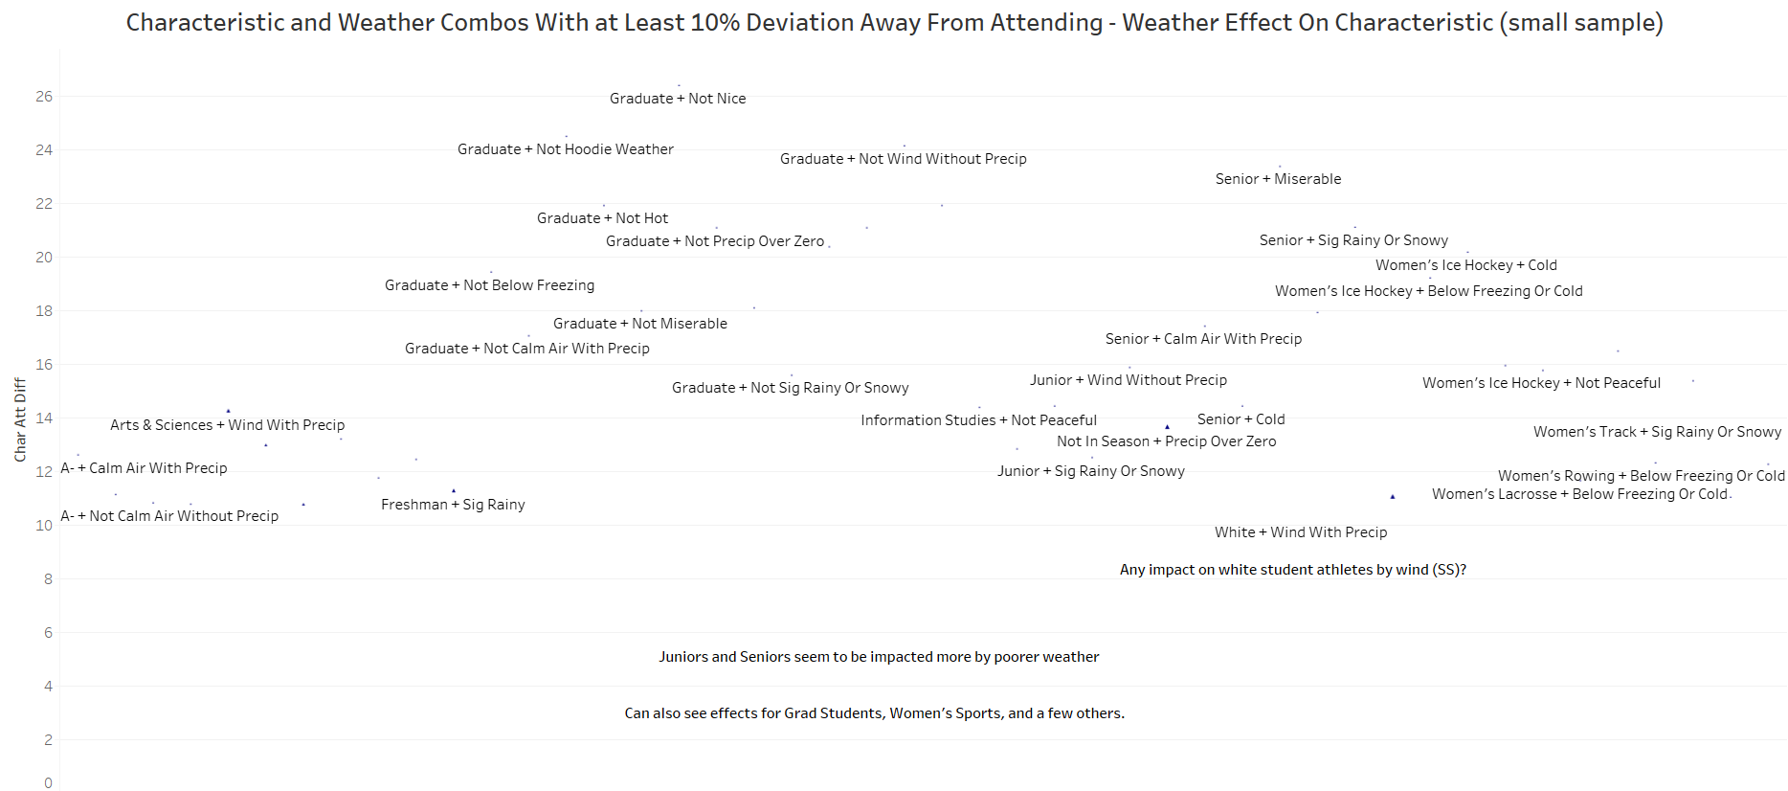

Slide 60
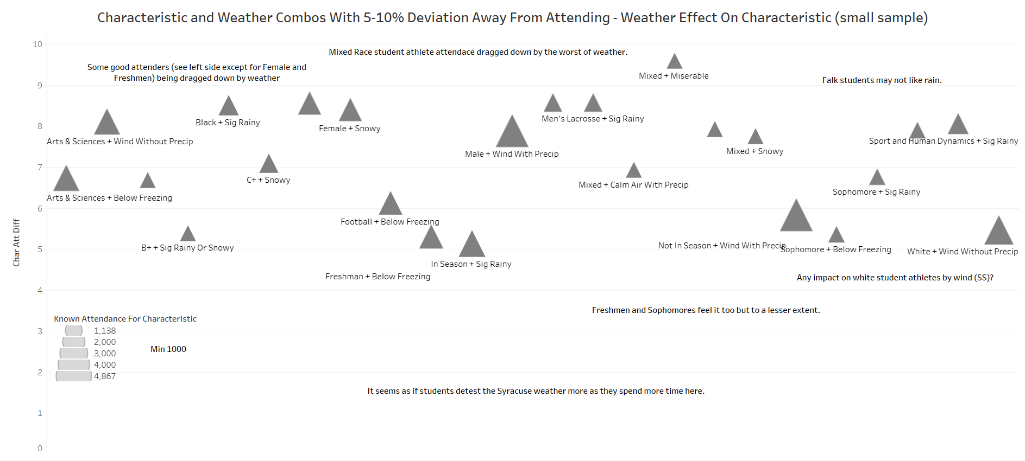

Slide 61
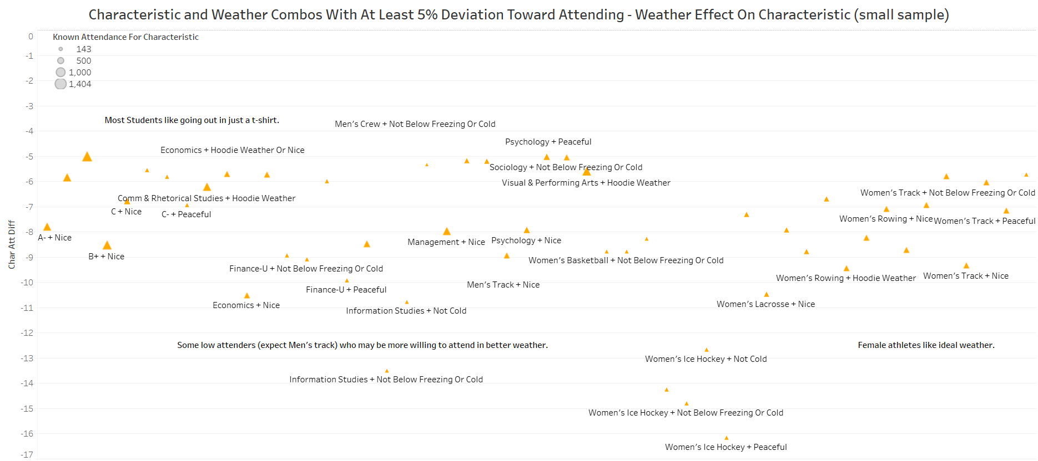

Slide 62
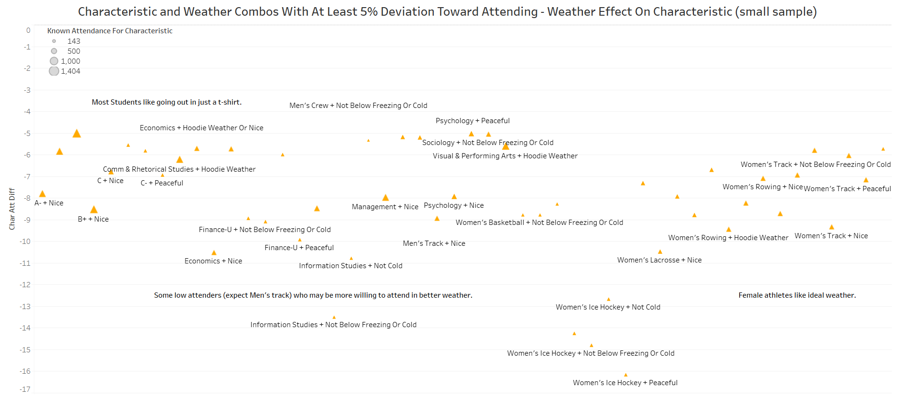

Slide 63
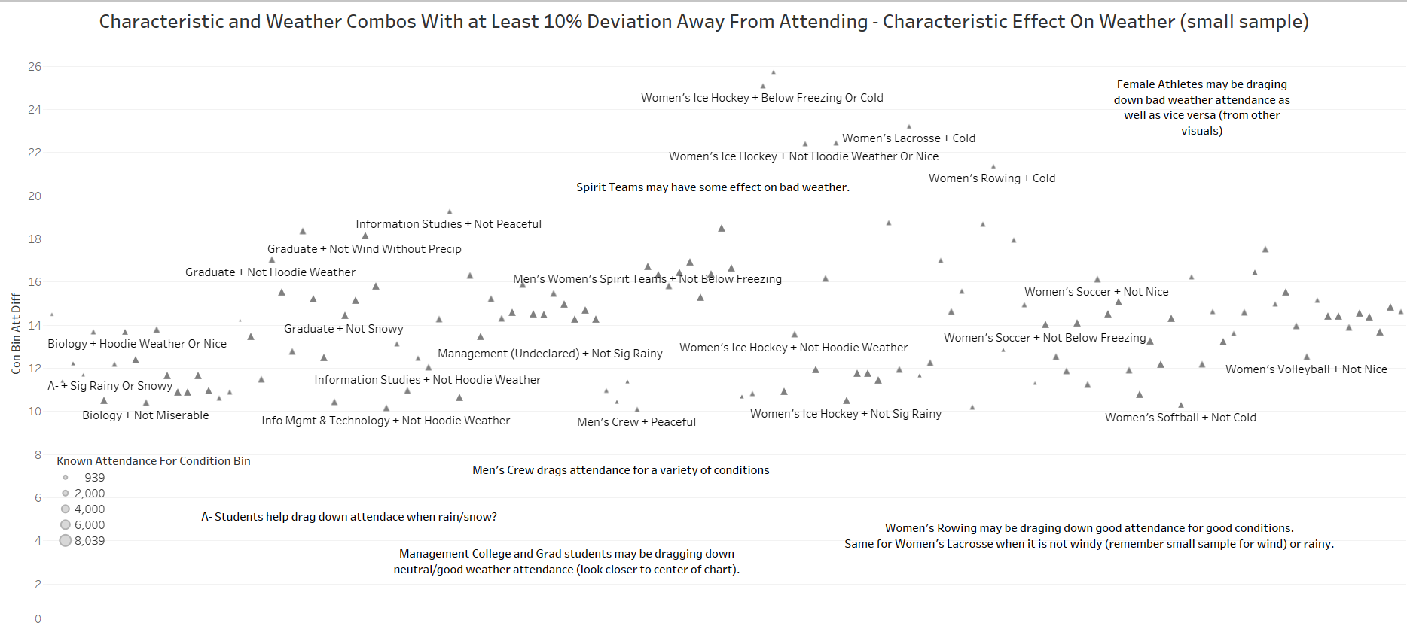

Slide 64


Slide 65


Slide 66


Slide 67
Question 7: What characteristics are shared by student-athletes who most, or least, often change their majors? Who intra-university transfer? What characteristics correlate with longer periods of "undeclared" major status?

Slide 68


Slide 69


Fall Count denotes transfers OUT, Spring Count denotes transfers IN

Slide 70
Insights Gained
Possible Changes
The highest number of "Undeclared" students reside in Men's sports, most notably lacrosse and football.
Declaring a major happens quickly overall in our dataset, typically less than 3 semesters
GPA is completely unaffected by declaration
Most common College Transfers happen OUTBOUND from SHD and A&S, but A&S and Professional Studies are the most transferred into
Most common Major Changes happen from A&S-U, likely into Psych or Finance
No Recommendations

Slide 71
Question 8: Which schools and colleges have the highest and lowest percentage response rates for completion of professor grade checks?

Slide 72


Slide 73
Insights Gained
Possible Changes
FYS and CHEM/BIO professors do a great job for the most part, with the number of reports written compared to students enrolled being greater.
PED has almost no grade checks written.
A lot of Gen Ed/ "weed out" type course codes that are taken early do a good job of writing grade checks, which is a good thing.
PED, PHI, PSY, SOC do a very bad job of writing reports considering the number of students enrolled in those course codes.
Ideally (in our own assumptions), every student should have a grade check accounted for, with best case scenario being multiple per student.
Classes with a large student athlete population (Philosophy, Psych, and Sociology) that produce less than 1/3 of grade checks per student athlete enrolled is a little problematic. Especially with Psych/Soc being majors transferred into at a higher rate .
Lower level course progression should garner more grade checks for these subjects

Slide 74
Question 9: What characteristics are shared by tutors who most consistently complete tutor reports? Who most often leave these incomplete?

Slide 75


Slide 76


Slide 77


Slide 78


Slide 79
Question 10: What characteristics are shared by tutors who are designated as instructional assistants?

Slide 80


Slide 81

When Did IAs Get Their Start

Slide 82

What Are IAs' Standing

Slide 83
IA STudents Also Have A Higher GPA Than Their Counterparts
Avg IA GPA = 3.76
Avg non-IA GPA = 3.71

Slide 84
Question 11: To what extent does feedback shared by professors via grade checks and/or Orange SUccess flags/kudos correlate with student-athletes' final grades?

Slide 85

INSIGHTS + POSSIBLE CHANGES
We tested this model with 3 different groups:
- All student athletes
- All athletes with a 3.3 or higher
- All athletes with a 2.0 or lower
All of these models proved there is no correlation between the final grade increasing and the number of grade checks submitted.
As for future changes, this begs the question of how grade checks can help influence the final grade of those at risk or with lower grades.
Potentially Exam feedback is more helpful than assessment of course grades as a whole? Changing what denotes an "at risk" student? Requiring a student self-check alongside the grade check?
No correlation is found between difference in final grade from that at the grade checks when grade checks are completed.

Slide 86
Question 12: What classes are most often dropped by student-athletes? Withdrawn from? What schools and/or majors typically correlate with the highest amounts of drops and withdrawals?

Slide 87


These charts denote the number of students with withdrawals per college and the number of withdrawals per class code (with a WD percentage above 15%)

Slide 88
Question 13: What is the breakdown of rates at which student-athletes receive support in different levels of coursework (100/200/300/400/500+)?

Slide 89


Slide 90
Question 14: On which days of the week is tutoring most regularly attended? Most often cancelled?

Slide 91


Slide 92
Question 15: During which times of day are tutorial sessions most often attended? Most often cancelled?

Slide 93


Slide 94
Question 16: How many average credits per semester are transfer student-athletes typically awarded upon transferring into Syracuse University? How does this number change in correlation with deeper progress into one's degree (ex: second semester transfer vs third, vs fourth or fifth)

Slide 95


INSIGHTS
Transfer students garner a good amount of credits for the time they tend to transfer. Awarded credits tends to exceed Class Standing, especially as upperclassmen, which makes sense.
A&S + VPA are the most common colleges to transfer into. VPA transfers made up 63.2% of all transfer students last year.

Slide 96
Bonus: Which Majors have the most sessions scheduled by student athletes, for Tutors and Instructional Assistants?

Slide 97


Slide 98


